Slide 1

Coffee Shop Sales Dashboard
Sales Insights & Recommendations
Name :Mahesh Gowda M
Gmail :maheshgowdam849 @gmail.com

Slide 2






Dataset contain 12 columns and 3636 rows.
1.Date → Transaction date (daily sales record).
2.Month_name → Month of transaction (Jan, Feb, …).
3.Monthsort → Numeric value (1–12) used for sorting months in order.
4.Weekday → Day of the week (Mon, Tue, …).
5.Weekdaysort → Numeric value (1–7) for sorting weekdays correctly.
6.Time_of_Day → Part of the day (Morning, Afternoon, Evening).
7.coffee_name → Name of the coffee product sold (Latte, Americano, etc.).
8.Transaction_ID (Card) → Unique ID representing each transaction.
9.cash_type → Payment method (Cash or Card).
10.Sales → Sales revenue for that transaction.
11.Size → Cup size (Small, Regular, Large).
12.Quantity → Number of units sold in the transaction.

Slide 3
KPIs
1.Sales Performance
-Total sales, transactions, average transaction value.
2.Product Insights
-Which coffee products sell the most (e.g., Latte, Americano).
-Contribution of each product to total revenue.
3.Time Insights
-Sales by Month (seasonal trends).
-Sales by Weekday (weekday vs weekend performance).
-Sales by Time of Day (morning vs afternoon vs evening).
4.Customer Insights
-Number of unique transactions.
-Average spend per transaction.
5.Payment Insights
-Split between Cash vs Card sales.
-Trend of payment methods over time.

Slide 4
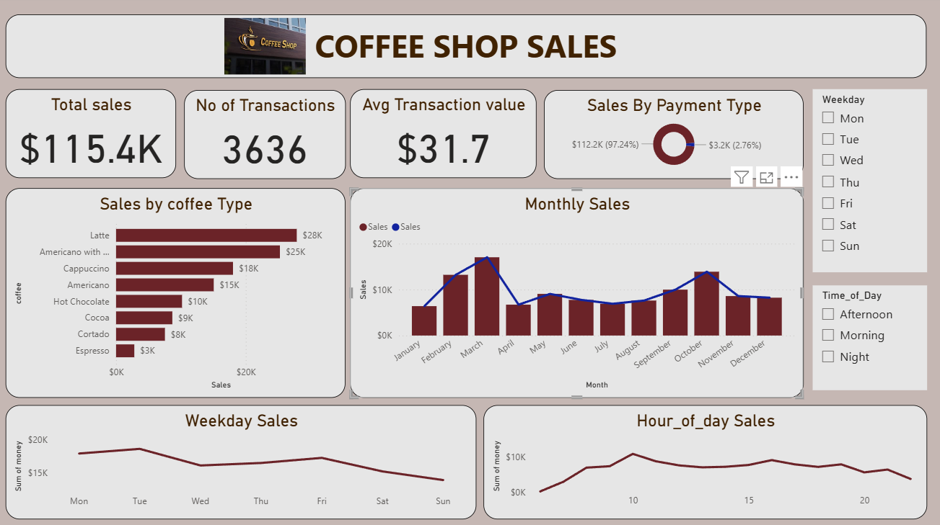

Slide 5

Thank you

